Slide 1
City of Beaumont
EIR Scoping Meeting
“Orchard Logistics
Center Project”
Presented By:
T&B Planning, Inc.
Date: August 3, 2022

Slide 2
Describe the Proposed Project
Provide information about the California Environmental Quality Act and the Environmental Impact Report (EIR) Process
Get input on the scope of the EIR
  What should be considered?
  What are your environmental concerns?
  Identify alternatives and potential mitigation measures
Identify the next steps and additional opportunities for public input
Purpose of the EIR Scoping Meeting

Slide 3
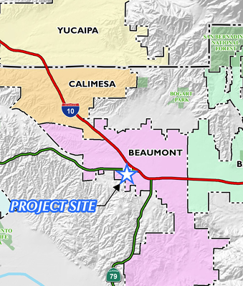
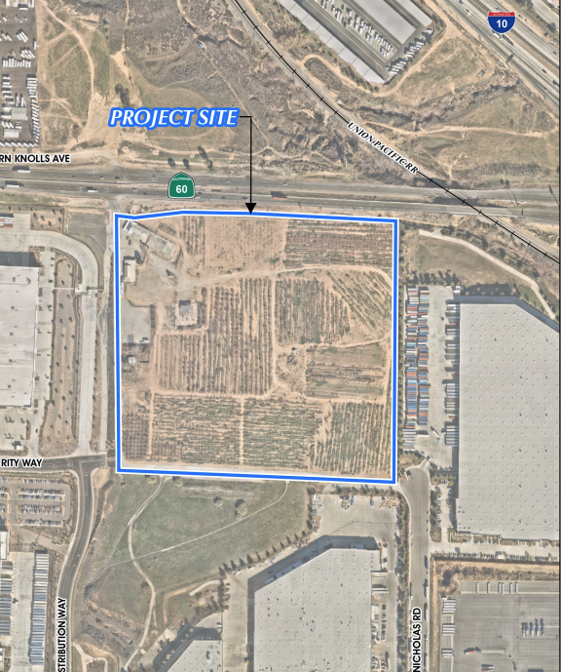
Project Location
Notes:
The Project site is an approximate 30.9-acre site located east of Western Knolls Avenue and south of the SR-60 Freeway, at 38021 SR-60 Freeway (Assessor’s Parcel Number [APN] 417-020—070), in the City of Beaumont. Regional access to the Project site is provided via the SR-60 Freeway at Potrero Boulevard and the SR-60 at Western Knolls Avenue to the west.
The Project site is developed with the former Dowling Fruit Orchard that includes an abandoned produce store and sheds on the northwestern corner of the site. Various types of fruit trees that are no longer cultivated or irrigated are present on the undeveloped portion of the Project site as well as disturbed plowed fallow land between plantings. Dowling Fruit Orchard is now closed and was formerly a family-owned business. Local access to the Project site is currently provided by Western Knolls Avenue to the west and Nicholas Road to the southeast.

Slide 4
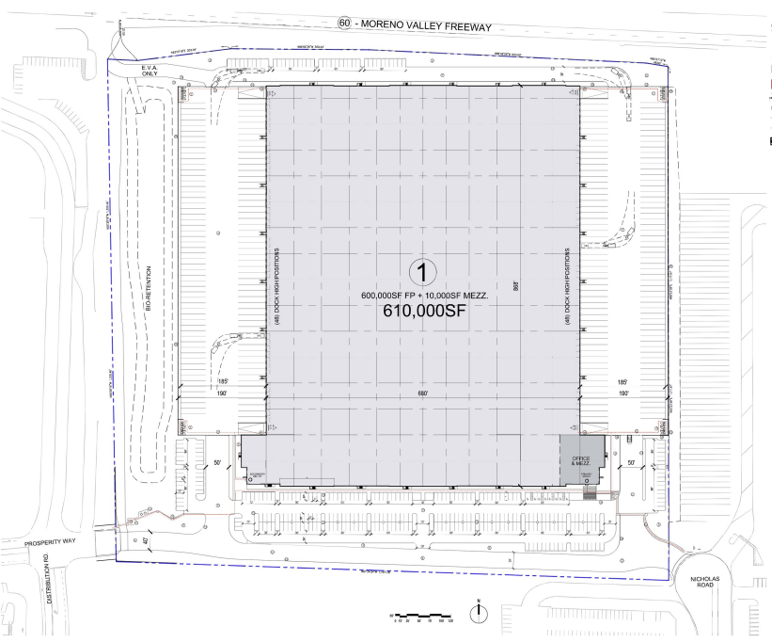
Site Area: 30.9 acres
Building Area:
590,000 sf Warehouse
20,000 sf Office
610,000 sf Total
Parking:
312 Auto
114 Truck Trailer
96 Dock Doors
Insert Project Site Figure
Site Plan
Notes:
Truck access to the Project site would be provided via a primary driveway on the southeast corner at Nicholas Road, with a secondary truck access to the intersection of Prosperity Way and Distribution Way. Primary auto and emergency vehicle access provided at the southwest corner at the intersection of Prosperity Way and Distribution Way, with a secondary point of access at the southeast corner to Nicholas Road.

Slide 5
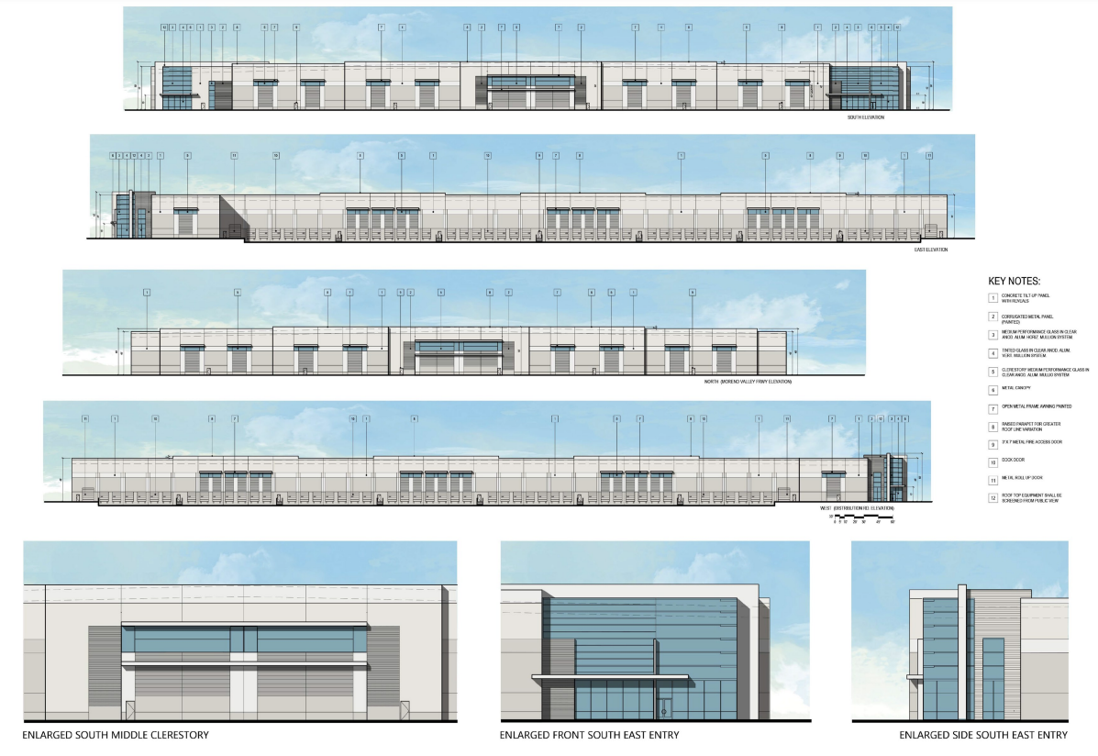
Insert Project Site Figure
Building Elevations [TO BE UPDATED]
Notes:
The proposed building would be constructed to be LEED equivalent with a maximum of 50 feet in height and designed in a contemporary architectural style. Architectural features associated with the building include the use of concrete tilt-up panels, corrugated metal accent paneling, tinted glass, metal canopies, and architectural reveals. The building would be painted with a mixture of four colors, including white, grays, and blue tones.

Slide 6
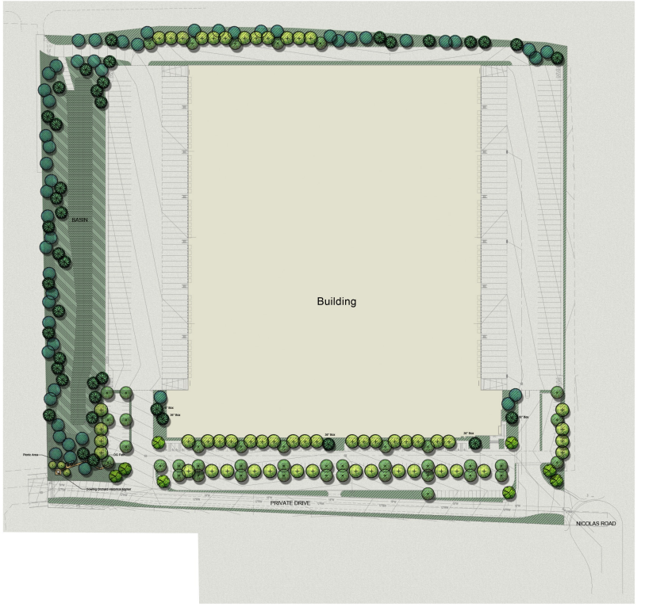
Landscaping will feature drought-tolerant plant materials.
A total of 194 trees
  13 36” box
  181 24” box trees
Preserving Orchard Trees
Landscaping Plan
Notes:
Landscaping will feature drought-tolerant plant materials: A total of 194 trees, including 13 36” box and 181 24” box trees. A bio-retention basin with a capacity of approximately 69,338 cubic feet would be constructed along the western property line.
Preserving several former orchard trees and installing them at the SW entrance to the property along with a plaque celebrating the Dowling Family’s history with their orchard on this property

Slide 7
California Environmental Quality Act
and
the Environmental Impact Report Process

Slide 8
Informational document that informs the public and decision makers about potentially physical environmental impacts of a project
Informational document that identified ways to avoid or reduce adverse environmental effects:
  Mitigation Measures (ways to reduce impacts)
  Alternatives (other ways of accomplishing the project’s objectives)
Environmental effects are just one of the factors considered by the decision makers when deciding whether or not to approve a project
What is an EIR?

Slide 9
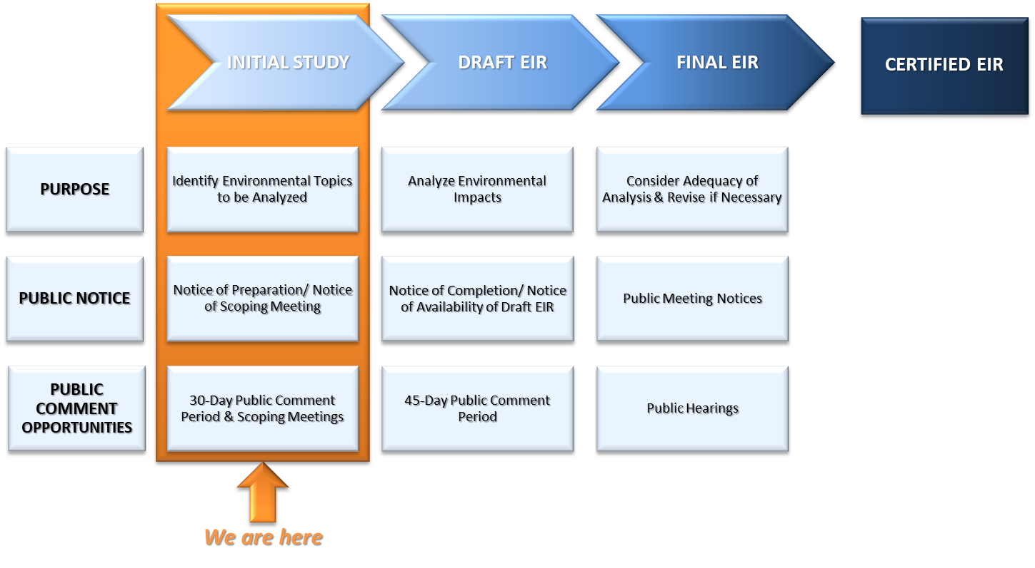

Slide 10
Work with City staff to prepare a technical document that:
  Analyzes the physical environmental impacts of the project
  Identifies ways to reduce impacts
  Clarifies the environmental issues
Provide guidance to the City with regards to complying with CEQA
The EIR Consultant is not an advocate for a particular decision
  Task is to assist in environmental issue identification and resolution
Role of the EIR Consultant

Slide 11
Responsible Agencies
  Beaumont-Cherry Valley Water District
  Regional Water Quality Control Board
  Riverside County Flood Control and Water Conservation District
  Southern California Gas Company and Southern California Edison
  South Coast Air Quality Management District
Trustee Agencies
  Native American Heritage Commission
Consultation with Responsible and Trustee Agencies

Slide 12
Aesthetics
Land Use & Planning
Mineral Resources
Population & Housing
Public Services
Recreation
Utilities & Service Systems
Resource Areas with Less than Significant impacts in the Initial Study
These topics will not be further analyzed in the EIR.

Slide 13
Agriculture & Forestry Resources
Air Quality
Biological Resources
Cultural Resources
Energy
Geology & Soils
Greenhouse Gas Emissions
Hazards & Hazardous Materials
Hydrology & Water Quality
Noise
Transportation
Tribal Cultural Resources
Wildfire
Resource Areas with Potentially Significant Impacts in the Initial Study
These topics will be further analyzed in the EIR.
Notes:
The EIR will analyze 13 environmental topics.

Slide 14
Contact Christina Taylor, Community Development Director
  ckendrick@beaumontca.gov
  (951) 769-8518
Write to:
  Carole Kendrick, Planning Manager
  City of Beaumont
  550 East 6th Street
  Beaumont, CA 92223
How to Stay Informed

