Slide 1

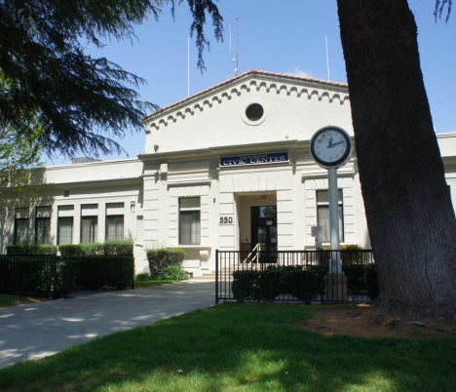
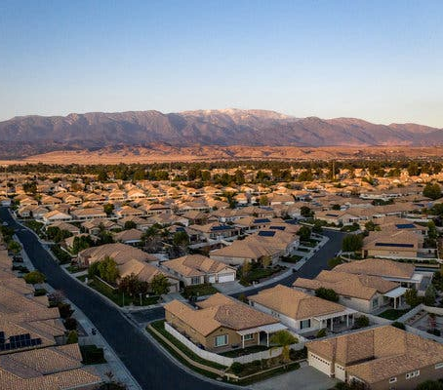
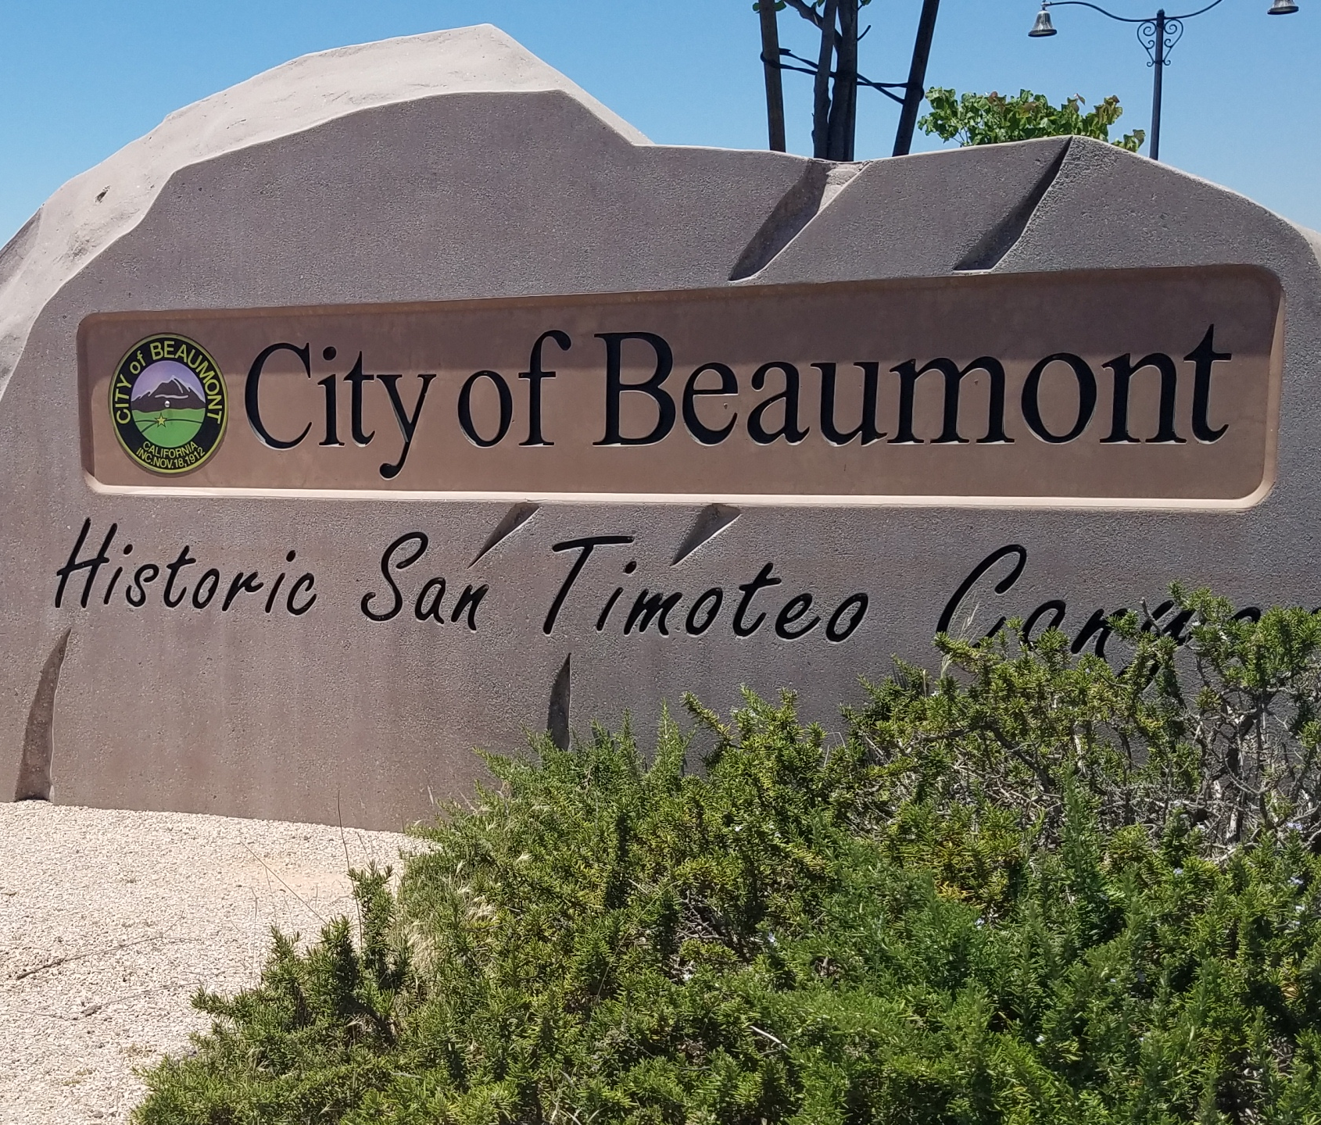
City of Beaumont
Housing Element Update
City Council Hearing
September 20, 2022

Slide 2
Presentation Outline
1 Housing Element Overview
2 Housing Needs and Conditions in Beaumont
3 Revised Draft Housing Element
4 Additional Actions
5 Recommendation and Next Steps

Slide 3
1
Housing Element Overview

Slide 4

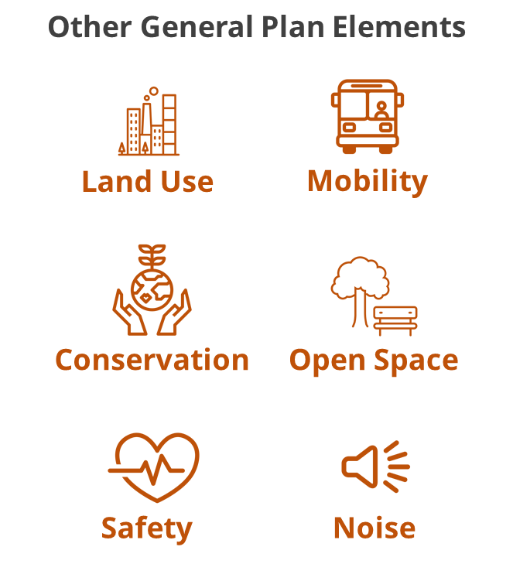
Housing Element Overview
The Housing Element is a required section of the City’s General Plan. It must:
Be updated every 8 years and certified by the State
Assess the residents’ housing needs and housing conditions
Show how the City will plan for its “fair share” of housing
Set citywide housing-related goals, policies, and programs
Cities are not required to build or initiate housing projects, but rather ensure zoning capacity exists to build housing

Slide 5

Housing Element Components
Policy and Programs Review
Housing Needs Assessment
Housing Constraints Assessment
Adequate Sites Inventory
Analysis of Fair Housing
Housing Resources Assessment
Implementation Plan

Slide 6
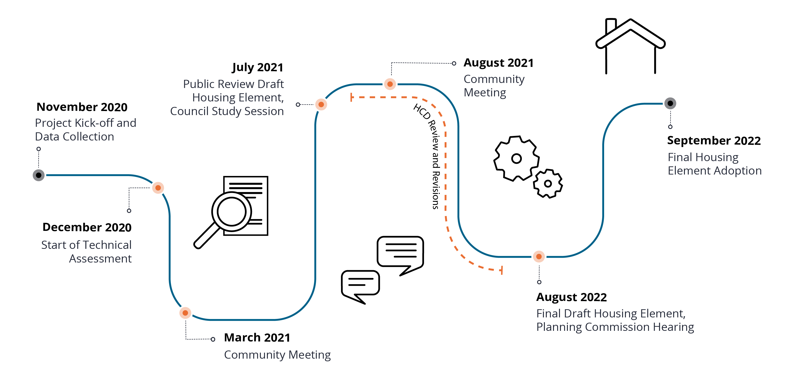
Update Process
WE ARE HERE

Slide 7

Public Outreach
Public Workshop – March 2021
Draft Housing Element
Council Study Session – July 2021
Planning Commission Workshop – August 2021
Online comment form
Targeted outreach in English and Spanish
Public Hearings

Slide 8
Housing Needs and Conditions in Beaumont
2

Slide 9
Household Income Distribution
About one-third (33%) of Beaumont households are lower income (earning less than 80% of Area Median Income (AMI))
Similar income distribution to Riverside County, but Beaumont has a higher household median income
Source: HUD CHAS, 2012-2016
AMI = Area Median Income
AMI for a 4-person household is $77,500

Slide 10
Housing Cost Burden / Overpayment
Beaumont residents experience a lower rate of housing overpayment than the region
Lower-income households are much more like to be housing cost burdened
More than 4 out of 10 renters in Beaumont are housing cost burdened
Households by Share of Income spent on Housing Cost | Households by Share of Income spent on Housing Cost:
Household Income Level | Not Cost Burdened (<30% of Income) | Cost Burdened (30-50% of Income) | Severely Cost Burdened (>50% of Income)
Extremely Low Income (< 30% HAMFI) | 11% | 12% | 77%
Low Income (30-50% HAMFI) | 21% | 29% | 49%
Low Income (50-80% HAMFI) | 32% | 37% | 31%
Moderate Income (80-100% HAMFI) | 43% | 43% | 14%
Moderate and Above Moderate Income (> 100% HAMFI) | 85% | 14% | 1%
Note: HAMFI refers to Housing Urban Development Area Median Family Income Source: SCAG 2020 Pre-Certified Local Housing Data (HUD CHAS, 2012-2016)

Slide 11
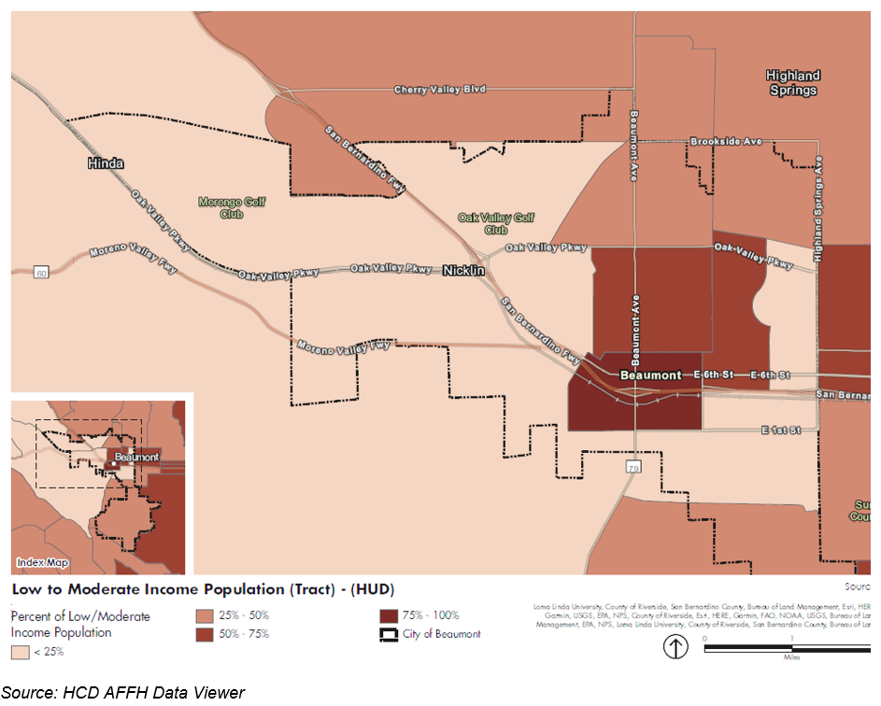
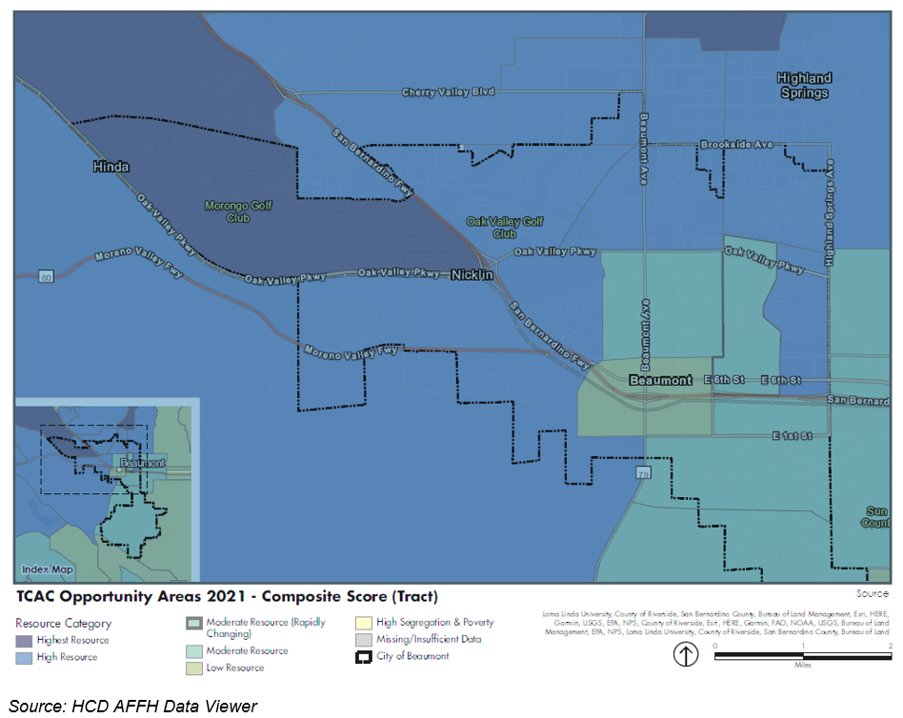
Income and Access to Opportunity

Slide 12
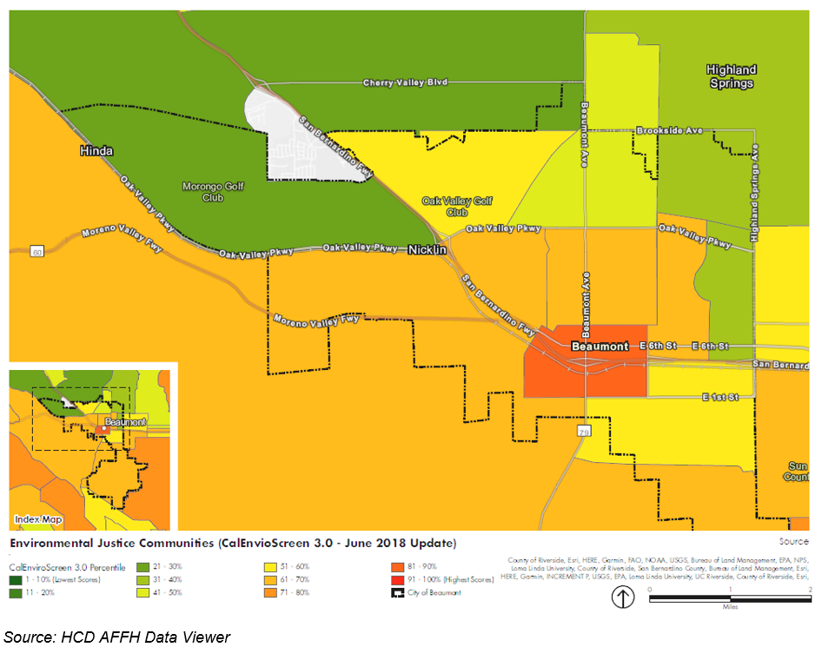
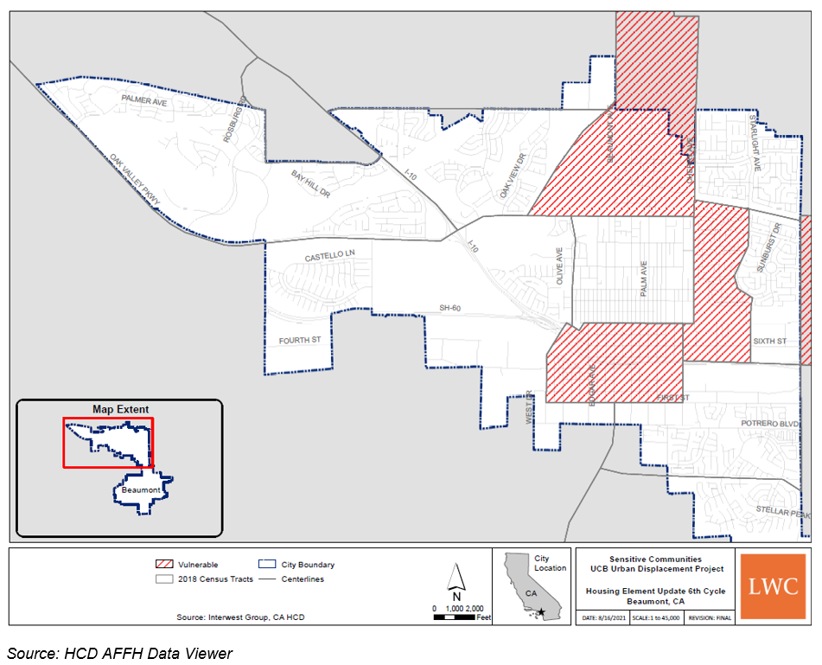
Environmental Conditions and Risk of Displacement

Slide 13
Regional Housing Needs Allocation (RHNA)
Regional Housing Needs Allocation or RHNA:
Projected number of new housing units needed
Each jurisdiction must show it can accommodate its total RHNA number, and its allocations by income level
Mandated by State law
 | SCAG Region | Beaumont
 | 6th Cycle RHNA | 6th Cycle RHNA Share
Very Low 30-50% AMI | 351,796 | 1,229
Low 50-80% AMI | 206,807 | 721
Moderate 80-120% AMI | 223,957 | 723
Above Moderate >120% AMI | 559,267 | 1,537
Total | 1,341,827 | 4,210
Median income 4-person household: $77,500

Slide 14
Revised Draft Housing Element
3

Slide 15

Draft Housing Element & Revisions
Draft Housing Element released July 2021
Revisions incorporated based on:
Public comments
Residents
Planning Commission
City Council
Affirmatively Furthering Fair Housing analysis
HCD comments

Slide 16
Table of Contents
Section I Introduction
Section II Projected Housing Need
Section III Housing Resources
Section IV Housing Plan
Goal A: Facilitate Housing to Accommodate RHNA
Goal B: Promote Housing for Lower- and Moderate- Income Households
Goal C: Remove Governmental Constraints to Housing
Goal D: Conserve and Improve Existing Affordable Housing Stock
Goal E: Promote Housing Opportunities For All Persons
Goal F: Encourage Energy Conservation
Appendix A: Housing Needs Assessment
Appendix B: Sites Inventory and Methodology
Appendix C: Housing Constraints
Appendix D: Existing Programs Review
Appendix E: Public Participation Summaries
Appendix F: Affirmatively Furthering Fair Housing

Slide 17
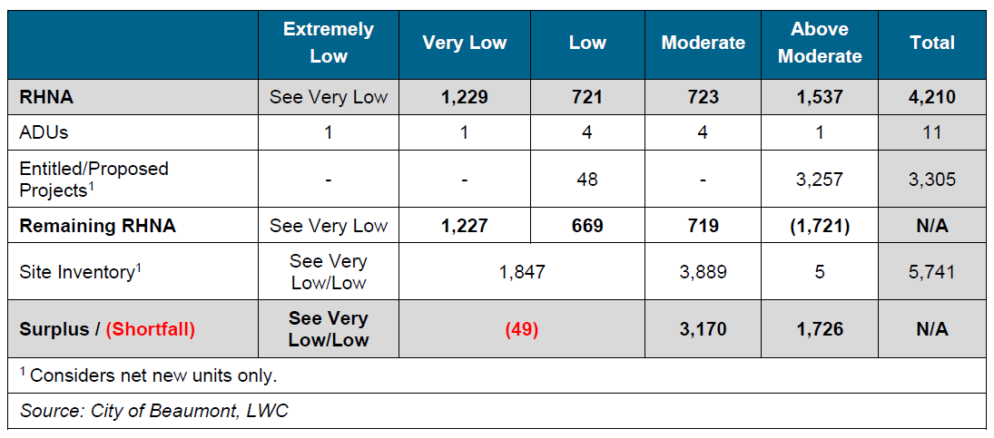
Sites Inventory
Notes:
Reduced capacity estimates for Moderate from PRD

Slide 18
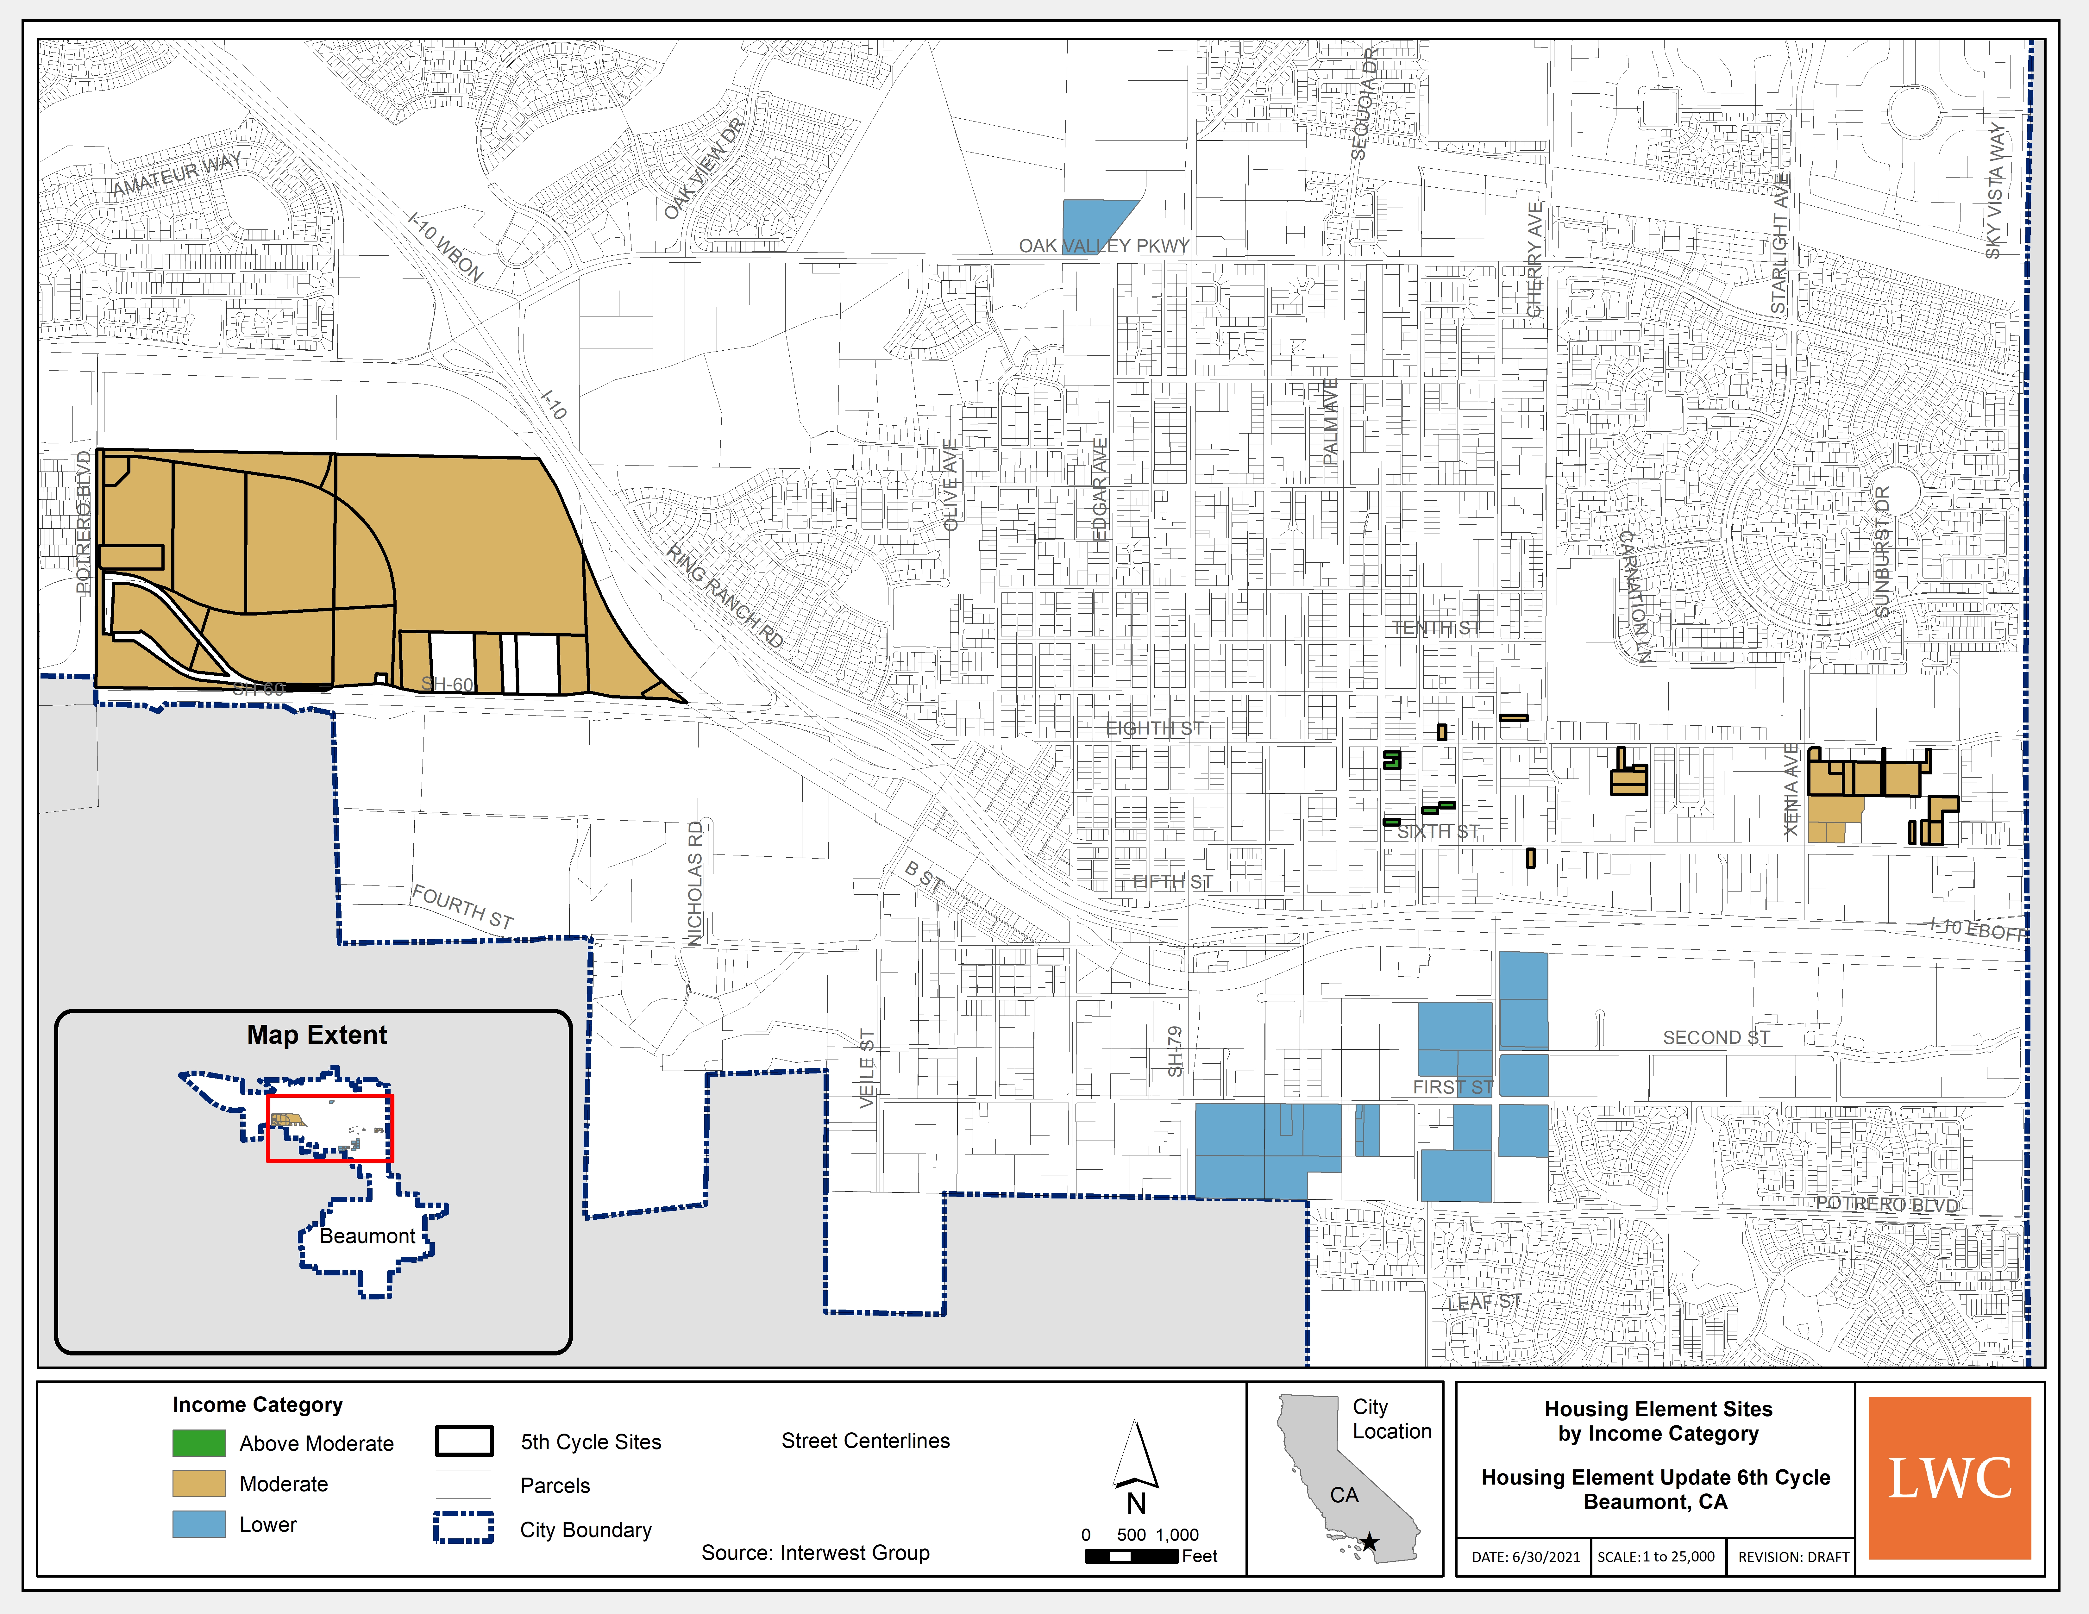
Sites Inventory
Sites identified on the map are under no obligation to construct affordable housing.
Notes:
No change from PRD

Slide 19
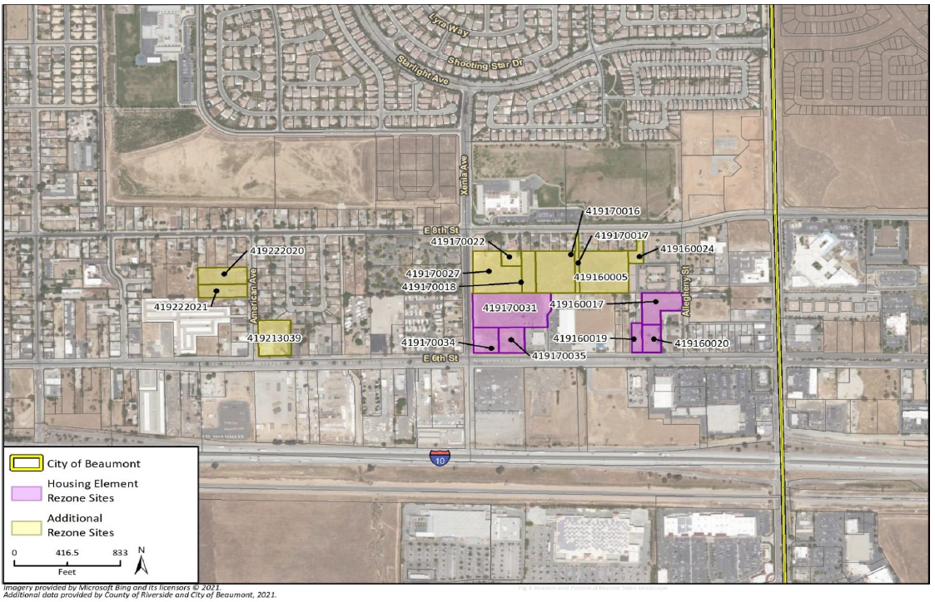
Sites Inventory – Sites for Rezoning
Sites identified on the map are under no obligation to construct affordable housing.
Notes:
No change from PRD

Slide 20

Key Programs
RHNA Housing Sites Implementation; Rezone Program (Program #1)
To accommodate lower-income RHNA shortfall, the City will identify and rezone a minimum of 2.5 acres of vacant land to a minimum of 20 and maximum of 30 units per acre. Rezoned sites shall allow 100% residential use and require residential to occupy at least 50% of the floor area in a mixed-use project.
Minimum Densities (Program #5)
The City will establish minimum densities on housing sites in the sites inventory where minimum densities do not currently apply, ensuring sites are developed at densities to meet realistic unit estimates.

Slide 21
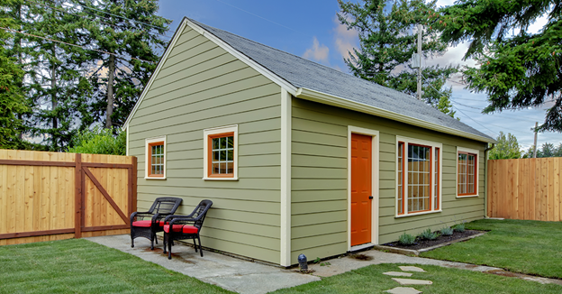
Key Programs
Accessory Dwelling Units (ADUs) (Program #4)
The City will adopt an ADU ordinance consistent with current state laws and prepare ADU standard plans to streamline the permitting and production of ADUs.
Affordable Housing Density Bonus Program (Program #12)
The City will update its Zoning Code to be consistent with state law.
Enhanced Density Bonus Program (Program #13)
The City will evaluate increasing density bonus provisions for projects that include affordable housing above that required by state law (e.g., more than the 50% density bonus).

Slide 22

Key Programs
Mixed-Use Parking Incentives (Program #18)
The City will analyze parking requirements in mixed use zones (e.g., downtown, urban village, and transit-oriented development areas, etc.) to determine if reductions in required parking rates and/or strategies that allow for parking reductions should be considered and included in the Zoning Code.
Objective Design Standards (Program #19)
The City will adopt objective design standards for residential and mixed-use projects.

Slide 23
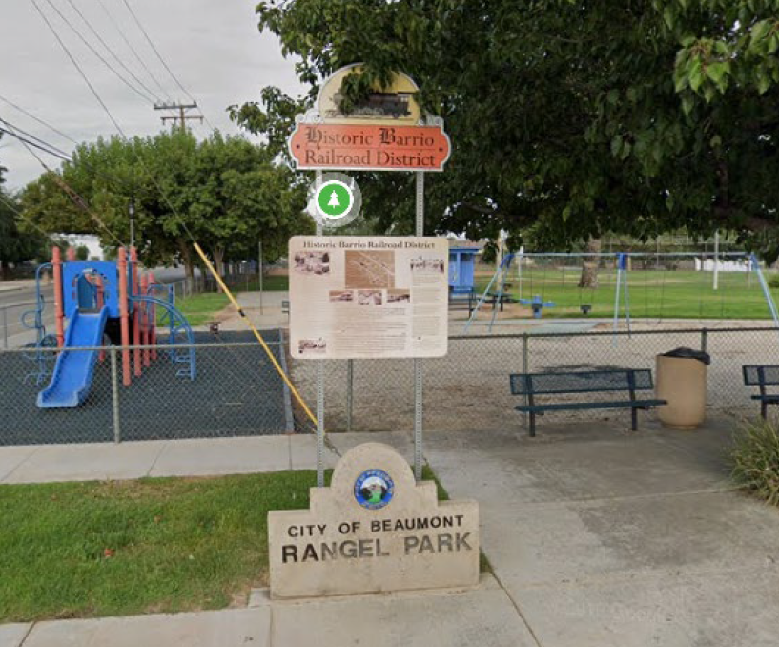
Key Programs
Target Housing Development in High Resource Areas (Program #32)
The City will provide written material to property owners of housing sites in high resource areas to describe potential residential capacity for the site and available incentives for development.
Environmental Justice Implementation (Program #36)
The City will implement the Environmental Justice Element to remediate negative environmental conditions in the vicinity of existing residential neighborhoods and in housing sites identified in the Housing Element.
Park Improvements and Access for El Barrio Neighborhood (Program #37)
The City will promote access to affordable and safe physical activity options in the El Barrio neighborhood by working with El Barrio residents to identify and implement improvements to Rangel Park.

Slide 24
4
Additional Actions

Slide 25
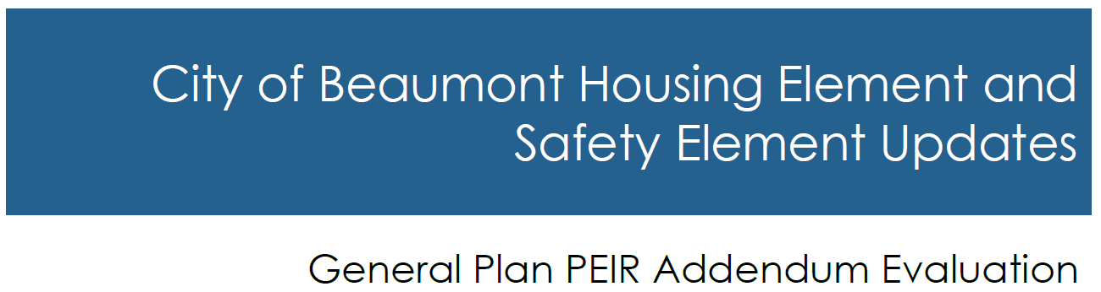
Additional Actions
Zoning Code and Zoning Map amendments to implement Housing Element programs
Safety Element updates triggered by Housing Element update
EIR Addendum

Slide 26
Recommendation and Next Steps
5

Slide 27

Recommendation and Next Step
Recommendation
Adoption
Next Step – HCD Review
HCD review/certification within 60 days of submittal of adopted Housing Element

Slide 28
Thank you!

